Slide 2
Multi-family Groups in Belgium
Saskia Verbesselt - Martine Lambrechts

Slide 3
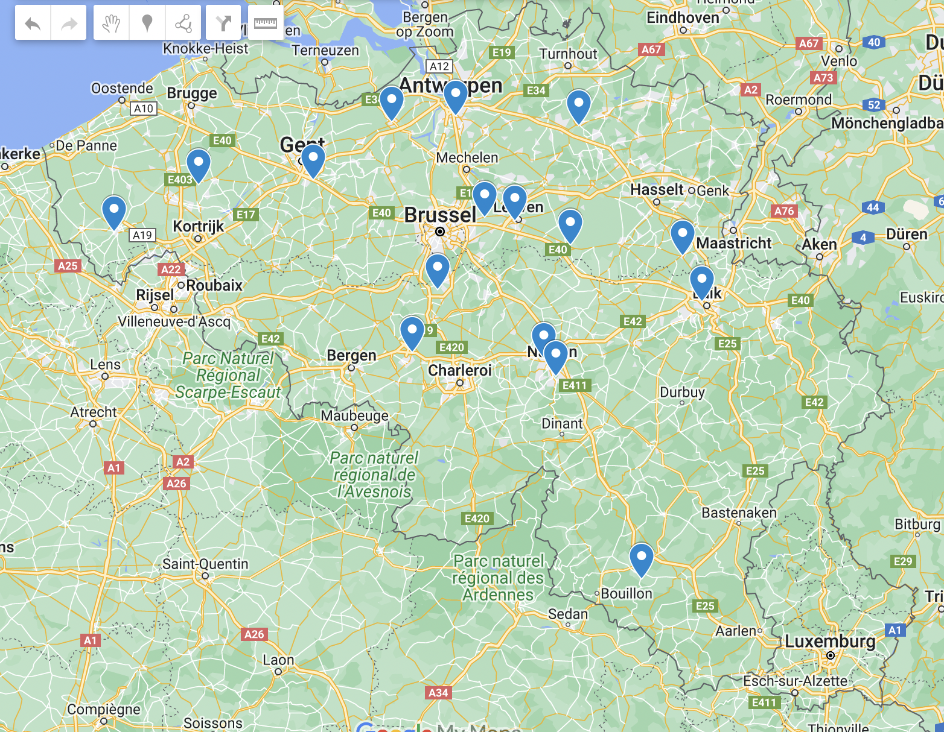
Geography
Flanders: 18 questionnaires
1 from an ambulatory practice
17 from 6 different psychiatric hospitals
Wallonia: 6 questionnaires
from 6 different psychiatric hospitals

Slide 4
Professional background of the MFG-therapist

Slide 5
Professional background of the MFG-therapist

Slide 6
Characteristics of the Multi-family Groups
Eating problems
6 MFG adolescents and young adults
(1 Wallonia - 5 Flanders)
Addiction
2 MFG adolescent/young adults
3 MFG adults
(0 Wallonia - 5 Flanders)
Heterogeneous
5 MFG adolescent/young adults
3 MFG adults
(4 Wallonia - 4 Flanders)
Psychosis
1 MFG adolescent/young adults
2 MFG adults
(0 Wallonia - 3 Flanders)
Affective disorder
2 MFG adults
(1 Wallonia - 1 Flanders)

Slide 7
Characteristics of the Multi-family Groups
Eating problems
4 MFG on model of Maudsley (psycho-education)
2 MFG closed groups: fortnightly, or 1d/w for 2 months
Addiction
1 MFG open group, fortnightly
4 MFG closed groups: series of 4/5 sessions, fortnightly
Heterogeneous
1 MFG psycho-education, 4x/year
5 MFG open group, fortnightly or monthly
2 MFG closed groups: series of 6 sessions, fortnightly or monthly
I
Psychosis
1 MFG on model of Mc Farlane (psycho-education)
2 MFG on model of Badaracco
Affective disorders
1 MFG open group, monthly
1 MFG closed groups: psycho-education, weekly

