Slide 1
Multifamily Groups In Mental Health
2nd Transnacional Meeting, Lisboa, 24 February 2023
The Importance of the Family Involvement in Mental Health Treatment
FamiliarMente
Portuguese Federation of Associations of Families of People With Mental Illness Experience

Slide 2
who we are?
A national federation of associations of families of people with experience of mental illness, non-profit organization whose main mission is to give voice to the families of people with mental illness, in defense of their rights and legitimate interests.
It was constituted on 31 March 2015 by 12 associations, founding members and currently has 14 affiliated associations,

Slide 3
ITS OBJECTIVE GENERIC
On behalf of the associations of the families, exercise the rights of citizenship and participation, in defense of better living conditions, health and well-being, of themselves and their families with experience of mental illness.

Slide 4
Main Objetives
To suport and defend the legitimate rigths and interests of families of people whit mental illness experience;
To promote, defend and stand on policeis to support and follow-up of families of people with mental illness;
To defend and advocate for health policy, education and training to ensure the prevention, treatment, monitoring and integration of people wiht mental illness;
To promote positive social undsertanding without discrimination of families and people with mental illness;
To streamline associations of families of people with mental illness in order to ensure organized expression in defending their interests

Slide 5
MAIN ACTIVITIES OF PARTICIPATION AND REPRESENTATION
2016 - Effective member of EUFAMI and Launch of a Public petition "Urgent, Budget and Responses to Mental Health;
2017 - Defense of the Public Petition; Approval of Resolution of the Assembly of the Republic, nº 213/2017 - Recommends to the Government to imple, etação and decolation of the Nacional Mental Health Plan;
2017 - Appointment to the National Health Council and Appointment to the National Council of Mental Health;
2018 - Appointment of the Regional Council of Mental Health of the Lisbon Region;
2020 - Working group on the revision of the mental health law and Committee for monitoring the Implementation of the Legal Regime for Compulsory Internment;
2021 - Member of the Board of Eufami;
2022 - Regional Mental Health Councils - North, Centre, Lisbon, Alentejo and Algarve;

Slide 6
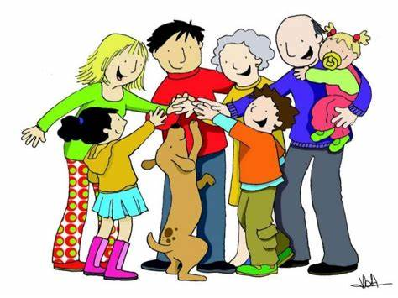
IMPACT OF MENTAL ILLNESS ON THE FAMILY
Like organic disease, mental illness affects the person, the family and resonates economically, emotionally and socially.
Family dynamics undergo substantial changes because mental illness alters the way a person behaves and relates and causes communication difficulties.
The FAMILY, lives and lives with the person and mental illness, 24 hours a day, 7 days a week, 365 days a year and without specialized follow-up.

Slide 7
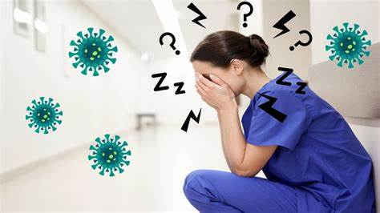
IMPACT OF MENTAL ILLNESS ON THE FAMILY MEMBER
Assumes CARING without experience.
CARES without the help of other family members or health and mental health professionals.
Stop having a life of your own / It alters your routines.
Subject to pressure, emotional, physical and economic.
You can leave your professional activity to pay attention to the needs of the family member.
Vulnerable financial situation, with loss of income from work and increased costs with the sustenance and health of the family member.

Slide 8
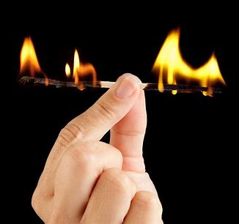
FAMILY CAREGIVER, the hidden patient
Feelings of guilt, helplessness and fear, for inappropriate and unpredictable behaviors to your family member.
Feelings of insecurity and shame, by the way society looks at its family member;
Feelings of sadness and anger, due to lack of attention of mental health professionals and lack of recognition as a partner in the treatment and rehabilitation of the family member;
The burden associated with care affects your health and well-being and causes physical and emotional exhaustion that needs attention and treatment;

Slide 9
Families Needs and people with mental illness
Make your voice heard in defense of your rights and those of the family member;
Valuing the role of the family in the treatment and rehabilitation process;
Access and equity to proximity mental health care;
Individual treatment plan with family inclusion;
Psychotherapeutic interventions for the sick person and family;
Community responses to psychosocial and professional rehabilitation;

Slide 10
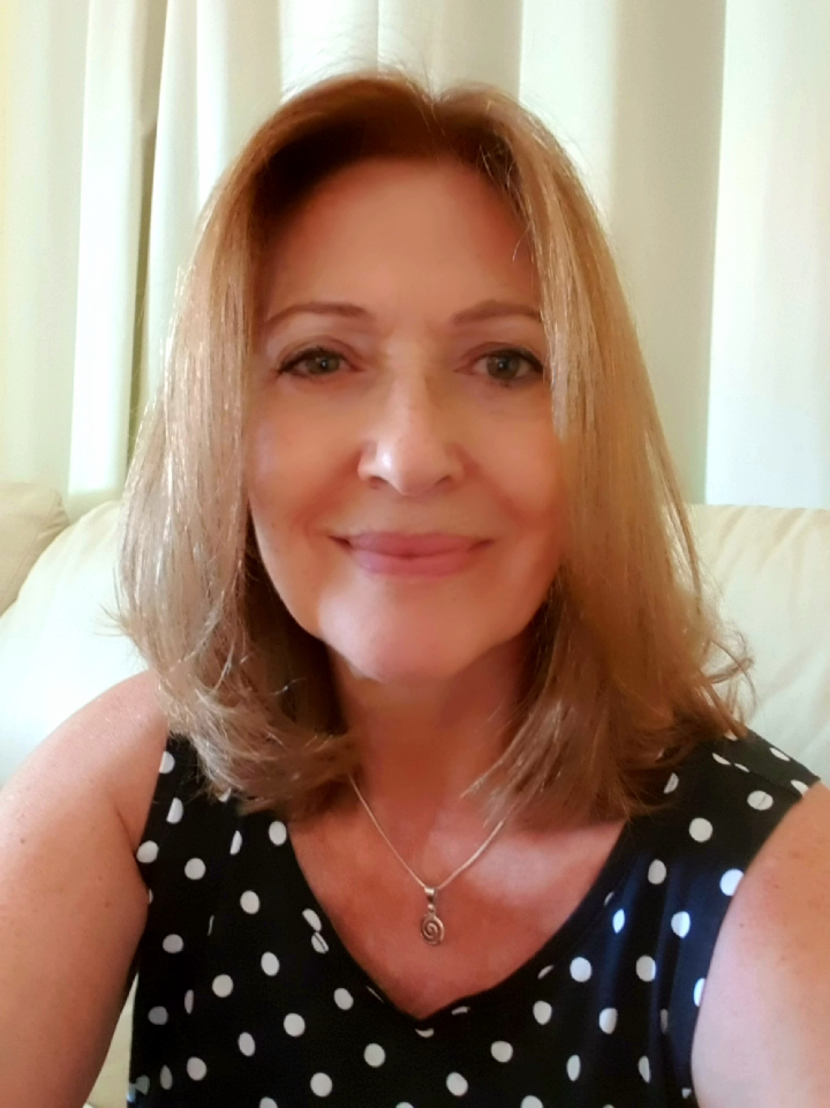
Thank you so much! My apologies for the english translation race! My mother tongue is the Portuguese ! Joaquina Castelão President of the FamiliarMente E-mail: familiarmente.geral@Outlook.pt

